Slide 1
EXPLORATORY DATA ANALYSIS

Slide 2
DESCRIPTION OF KAGGLE MILLONS SONG DATASET
NAME OF FILES | DESCRIPTION
Kaggle_users.txt | Contains individual user id data
Kaggle_songs.txt | Contains songs unique id
kaggle_visible_evaluation_triplets.txt | Contains user id ,song id and no.of times user listened the song(count)
taste_profile_song_to_tracks.txt | Contains song id and track id
unique_tracks.txt | Contains song id, track id, artist, song name

Slide 3
NAME OF FILES | DESCRIPTION
kaggle_visible_evaluation_triplets.txt | Contains user id ,song id and no.of times user listened the song(count)
unique_tracks.txt | Contains song id, track id, artist, song name
From five files we observed only these two files are most useful
The data contained in the other three files are already present in those two files
In the taste_profile_song_to_tracks.txt we observed there are more than one track id in some song , so we can drop them due to negligible among these dataset.
Track id is just like song id ,it is nothing but just a unique number to every song.

Slide 4
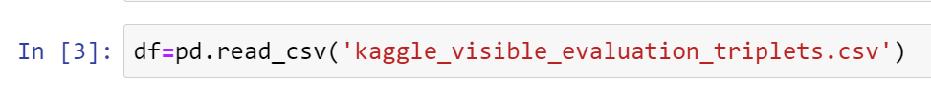
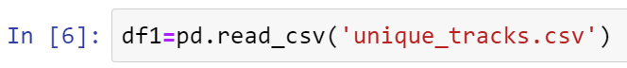
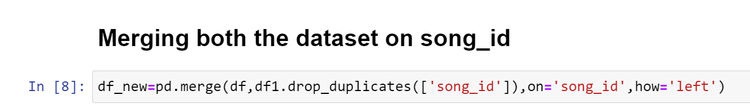
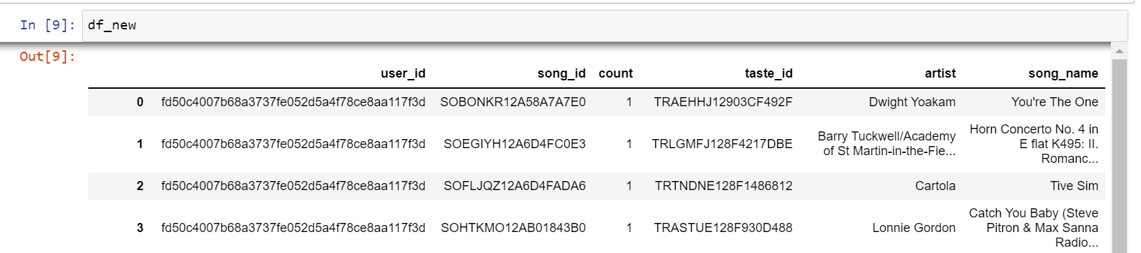
INTRODUCTION TO THE DATASETS

Slide 5
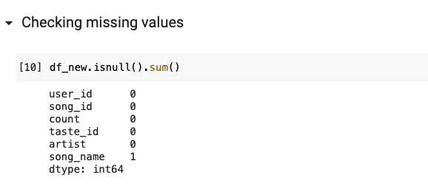
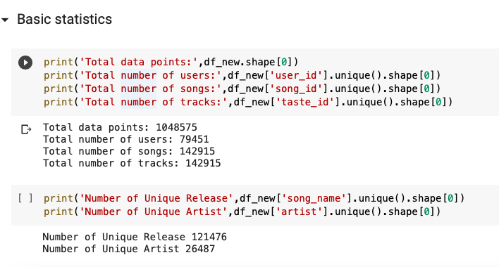
Refers to the critical process of performing initial investigations on data so as to discover patterns, to spot anomalies to test hypothesis and to check assumptions with the help of summary statistics and graphical representation.
We have performed following steps to analyze the dataset:
Checking missing values 2. Descriptive Statistic

Slide 6
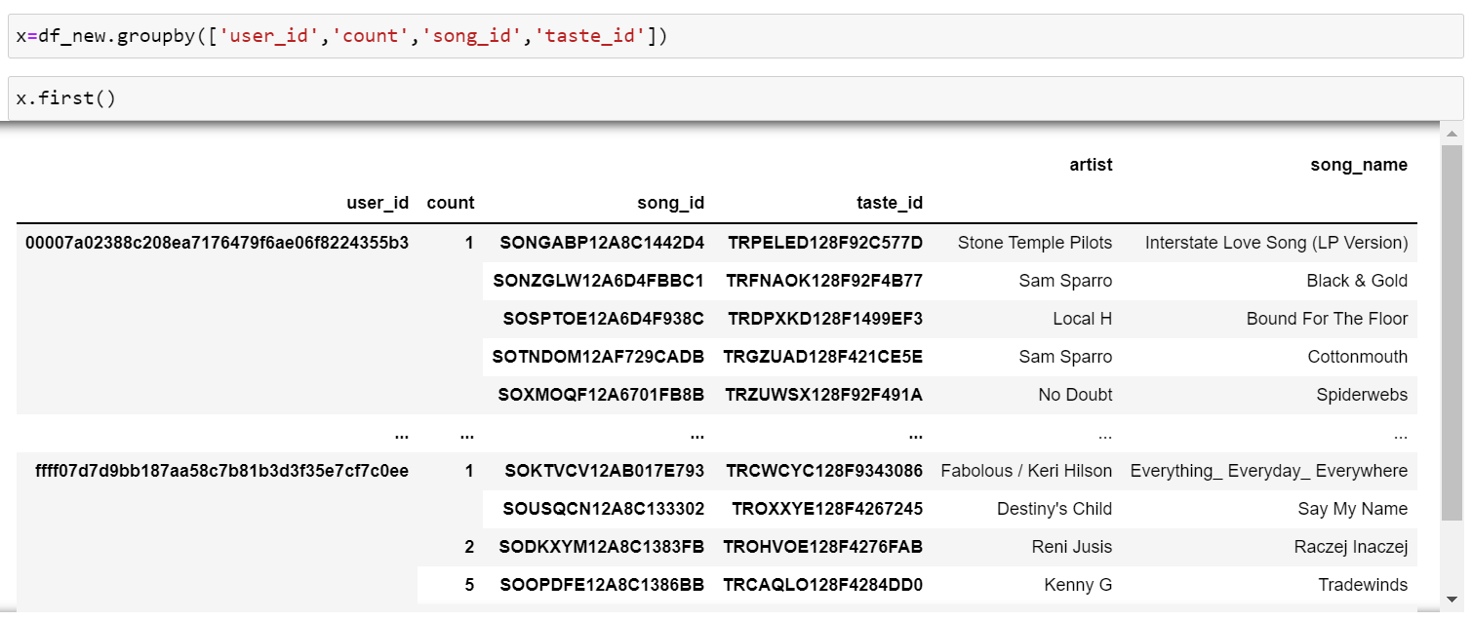
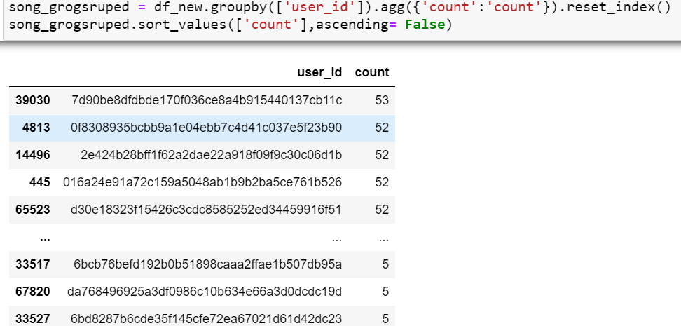
User Id
In this analysis we find the most user listened 53 tracks
And least active user listened only five tracks
Total number of user is 79451

Slide 7
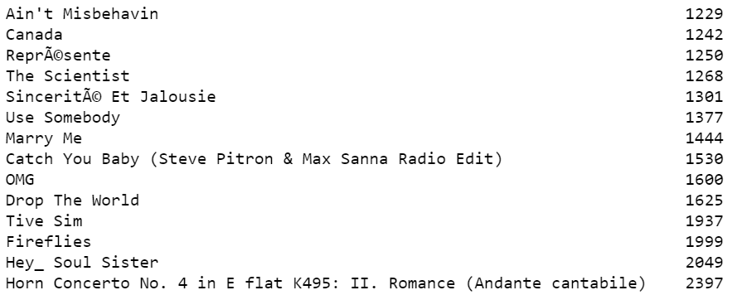
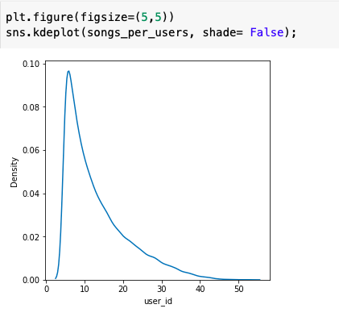
SONGS
Number of song listened per user
It is the no of times each song played
Total no of new track released 142915
No of times songs streamed by users is 3335779
From this graph we observed that only some song is played most no of times

Slide 8
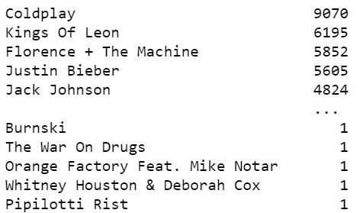
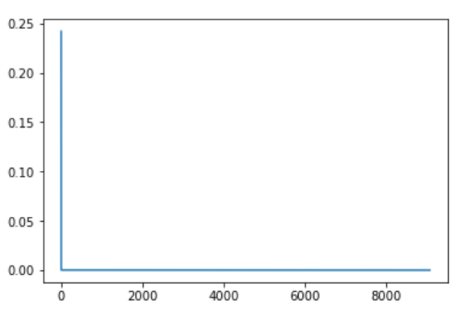
ARTISTS
Total no of unique artist in dataset is 26487
Pdf plot of artist
Most listened or popular artist in this playlist is coldplay with 9070 streams.
There are 76 unique track of coldplay in this playlist

Slide 9
FUTURE IMPLEMENTATION
90% of the EDA is done
Data Preparation is almost done
Now we have to implement following three algorithms
Popularity Based Recommendation System Implementation
Collaborative Filtering Based Recommendation System Implementation .
Content Based Recommendation System Implementation

Slide 10



